Slide 1
CS 211 Computer Architecture Lecture 30: RISC-V Single Cycle - Control Logic Design
Ravi Mittal
ravi.mittal@iitgoa.ac.in
Indian Institute of Technology, Goa

Slide 2
Acknowledgements
Class Presentation, RISC-V CPU Control, Pipelinging, CS61C, Great Ideas in Computer Architecture, University of Berkeley, Morgan Rae Rechenberg
Class Presentation, CS61C, Machine Structures, University of Berkeley, Dan Garcia and Miki Lustig, 2019
Class Presentation, CS61C, Introduction to Assembly Language and RISC-V Instruction Set Architecture, University of Berkeley, Prof Krste Asanović & Randy H. Katz. http://inst.eecs.Berkeley.edu/~cs61c
Computer Organization and Design, The Hardware Software Interface, RISC-V edition, Patterson and Hennessey
Digital Design and Computer Architecture: RISC-V Edition, Harris & Harris Elsevier – Presentation.

Slide 3
Last Class

Slide 4

Let’s try to design PCsel
Consider three cases:
Regular (non-control) instructions
Branches
Jumps
You may assume PCSel = 0 → PC = PC + 4,
PCSel = 1 → PC = ALUout
For regular instructions, PCSel is always 0, so our circuit looks like this
Ref: CS61C Morgan Reschenberg, Univ of California, Berkeley

Slide 5
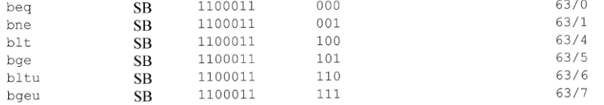
PCSel: Branch Instructions
How do we know if an instruction is a branch?
Check the green sheet (Instruction list)
In order: opcode, func3
They all have the same opcode! We should also check to make sure no other instructions have the same one!
Ref: CS61C Morgan Reschenberg, Univ of California, Berkeley

Slide 6
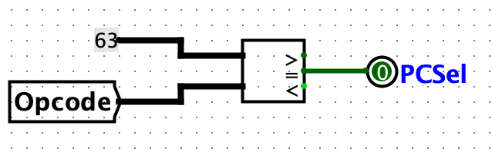
PCSel: Branch Instructions
Let’s describe the desired behaviour in words:
For a regular instruction, choose PC+4. For a branch instruction, choose ALUout
For a regular instruction, set PCSel = 0. For a branch instruction, set PCSel = 1
We can identify a branch instruction by doing an equality check on the opcode. Here’s our sub circuit:
Ref: CS61C Morgan Reschenberg, Univ of California, Berkeley

Slide 7
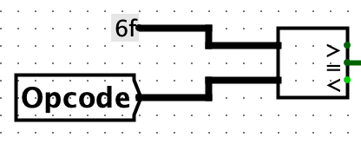
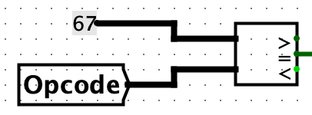
PCSel: Jumps
Which instructions are our jump instructions?
They are different, so no easy generalization
Same as with branching, though, we can do an equality check on the opcode using a comparator. We’ll have to do two separate comparisons here
Ref: CS61C Morgan Reschenberg, Univ of California, Berkeley

Slide 8
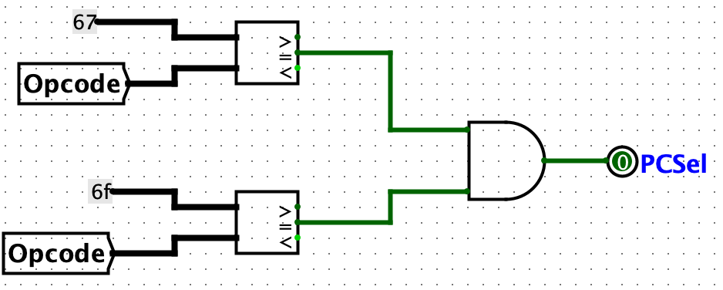
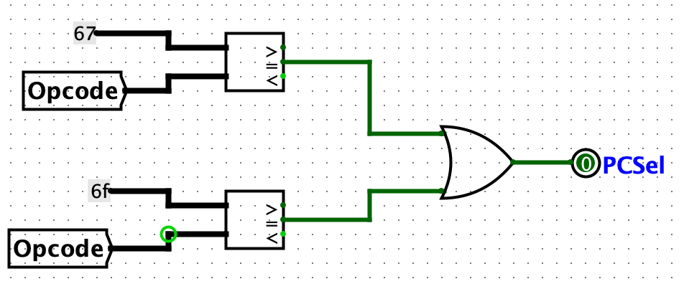
Trivia
Which of the following circuits is the correct PCSel for jumps?
A
B
Ref: CS61C Morgan Reschenberg, Univ of California, Berkeley

Slide 9
Putting them all together
Three cases
Regular instruction, or
Branch instruction, or
Jump instruction.
To combine all our signals together and retain the functionality of each individual piece, we’ll OR them
If any of the sub-circuits are true, PCSel will become 1
Otherwise, it’ll be 0
For all normal instructions will have PCSel = 0, while branch, jump will have PCSel = 1 as desired
Ref: CS61C Morgan Reschenberg, Univ of California, Berkeley

Slide 10
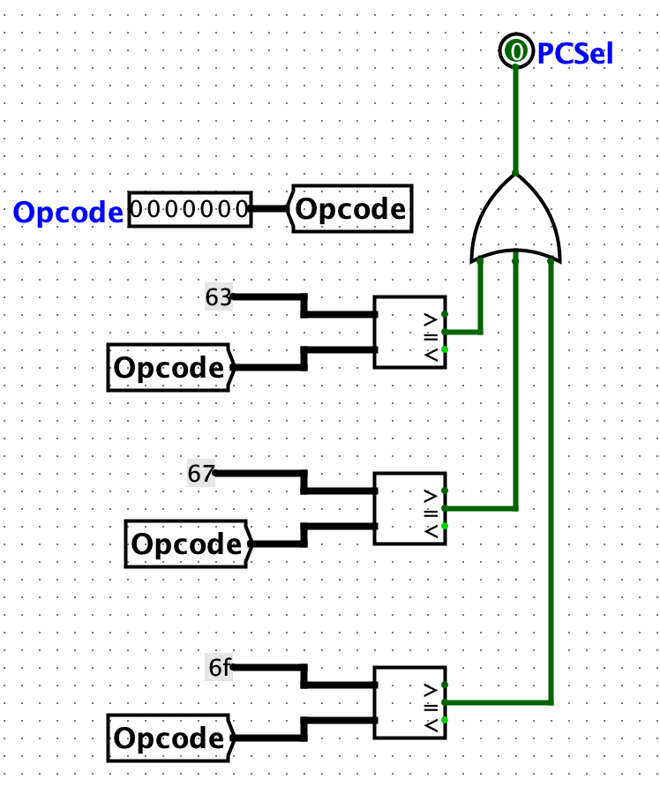
PCSel: Final Circuit
Ref: CS61C Morgan Reschenberg, Univ of California, Berkeley

Slide 11
Control Signals: Big picture
Control signals cause the same hardware to behave differently and execute different instructions
For every instruction, all control signals are set to one of their possible values or an indeterminate (*) value indicating the control signal doesn’t affect the instruction’s execution
Each control signal has a sub-circuit based on ~nine bits from the instruction format:
Upper 5 func7 bits (lower 2 are the same for all instructions we have used)
All func3 bits
Second upper opcode bit (others are the same for all instructions)
Ref: CS61C Morgan Reschenberg, Univ of California, Berkeley

Slide 12
In this class we will study
Control Logic Design for Add instruction
Performance of Single Cycle Datapath

Slide 13
Control logic for Add instruction

Slide 14
Control Signals: ADD
+4
Reg[]
pc
pc+4
pc
wb
1
alu
1
DataD
Reg[rs1]
ALU
2
alu
0
DMEM
0
IMEM
inst[11:7]
AddrD
Addr
1
pc+4
Branch Comp.
Reg[rs2]
DataR
wb
inst[19:15]
AddrA
DataA
0
0
DataW
mem
inst[24:20]
AddrB
DataB
1
inst[31:7]
Imm.
Gen
imm[31:0]
PCSel
inst[31:0]
ImmSel
RegWEn
BrUn
BrEq
BrLT
BSel
ASel
ALUSel
MemRW
WBSel
Ref: CS61C Morgan Reschenberg, Univ of California, Berkeley

Slide 15
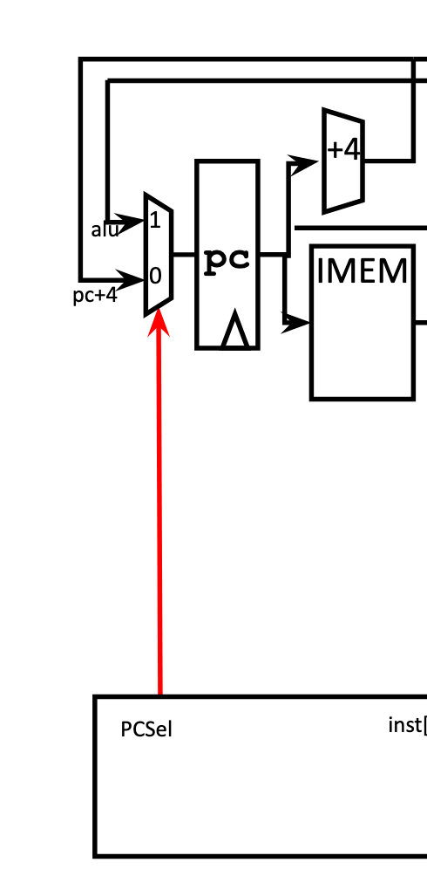
ADD: PCSel
Should we execute the next instruction (0), or jump control flow to the address given by our ALU output (1)?
This instruction is not a branch or jump
PCSel = 0
Ref: CS61C Morgan Reschenberg, Univ of California, Berkeley

Slide 16
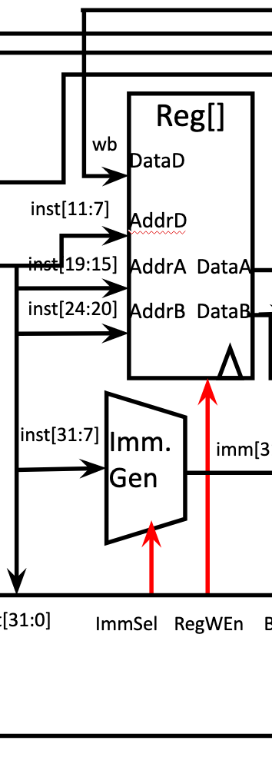
ADD: ImmSel, RegWEn
How do we want to assemble our immediate?
Wait… we don’t ? have one?
We DON’T CARE about this signal
ImmSel = *
Do we want to write (1) to our destination register rd, or not?
Add should write!
RegWEn = 1
Ref: CS61C Morgan Reschenberg, Univ of California, Berkeley

Slide 17
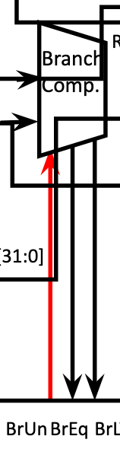
ADD: BrUn
When we compare R[rs1] and R[rs2], should the comparison be signed (0), or unsigned (1)?
We aren’t doing a branch !
This value doesn’t matter
BrUn = *
Ref: CS61C Morgan Reschenberg, Univ of California, Berkeley

Slide 18
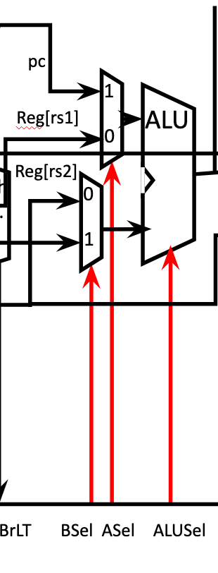
ADD: ASel, BSel, ALUSel
Which operands do we want to operate on?
ADD requires rs1 and rs2
ASel = 0 (rs1)
BSel = 0 (rs2)
What operation do we want to perform?
ADD == add ?
ALUSel = “Add”
but wait… that’s not binary, how does that work?
Ref: CS61C Morgan Reschenberg, Univ of California, Berkeley

Slide 19
ALUSel
For diagramming purposes, we set ALUSel to an english value (add, sub, or, etc.)
In your CPU, it’ll have a binary value (and so will all other signals)
The mapping between English words and binary values depends on how you build your ALU
These mappings are arbitrary. As long as you’re consistent (all add-based instructions have the same ALUSel) things will work just fine
Ref: CS61C Morgan Reschenberg, Univ of California, Berkeley

Slide 20
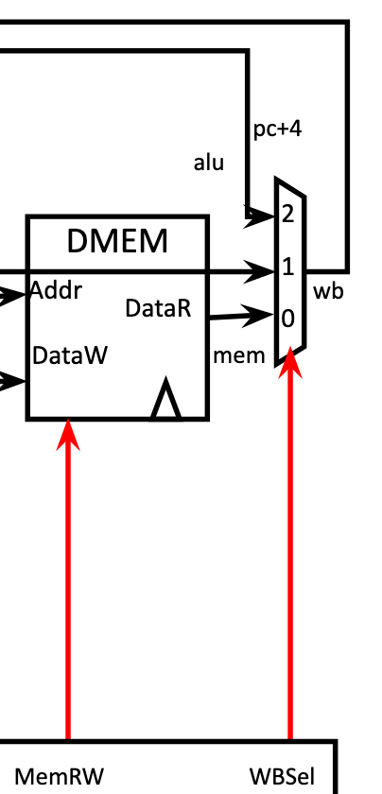
ADD: MemRW, WBSel
Are we reading (0) or writing (1) memory?
Wait, we’re not doing anything with memory. Can this be a “don’t care” value?
NO NO NO NO NO !
We never want to “accidentally” write memory. This has to be a “passive read”.
MemRW = 0
What value do we want to write back to rd?
ALU Out!
WBSel = 2
Ref: CS61C Morgan Reschenberg, Univ of California, Berkeley

Slide 21
ADD: Control Signals
Here are the signals and values we’ve compiled for ADD instruction:
(green = left 3 cols = Control INPUTS)
(orange = right 9 cols = Control OUTPUTS)
Inst[31:0] | BrEq | BrLT | PCSel | ImmSel | BrUn | ASel | BSel | ALUSel | MemRW | RegWEn | WBSel
add | * | * | +4 | * | * | Reg | Reg | Add | Read | 1 (Y) | ALU
Ref: CS61C Morgan Reschenberg, Univ of California, Berkeley

Slide 22
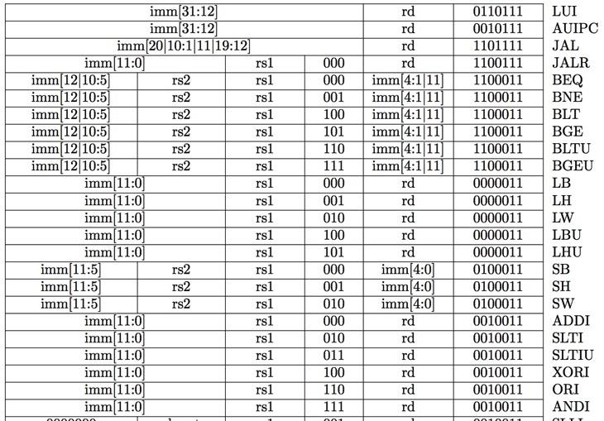
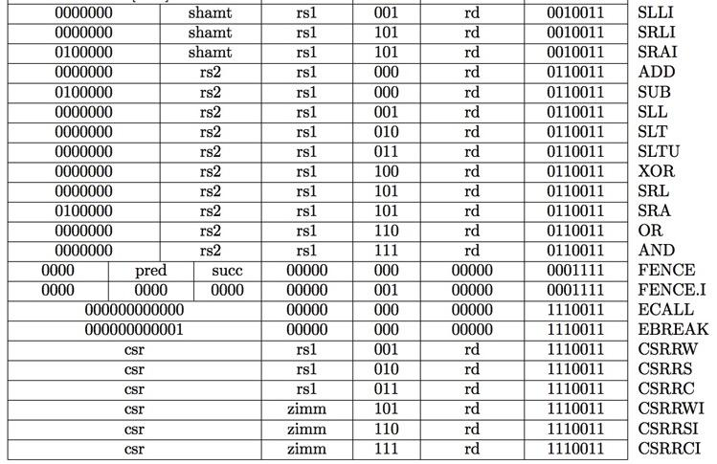
RV32I, a nine-bit ISA!
inst[30]
inst[14:12]
inst[6:2]
Not considered now
Instruction type encoded using only 9 bits inst[30],inst[14:12], inst[6:2]
Ref: CS61C Morgan Reschenberg, Univ of California, Berkeley

Slide 23
Inst[31:0] | BrEq | BrLT | PCSel | ImmSel | BrUn | ASel | BSel | ALUSel | MemRW | RegWEn | WBSel
add | * | * | +4 | * | * | Reg | Reg | Add | Read | 1 (Y) | ALU
sub | * | * | +4 | * | * | Reg | Reg | Sub | Read | 1 | ALU
(R-R Op) | * | * | +4 | * | * | Reg | Reg | (Op) | Read | 1 | ALU
addi | * | * | +4 | I | * | Reg | Imm | Add | Read | 1 | ALU
lw | * | * | +4 | I | * | Reg | Imm | Add | Read | 1 | Mem
sw | * | * | +4 | S | * | Reg | Imm | Add | Write | 0 (N) | *
beq | 0 | * | +4 | B | * | PC | Imm | Add | Read | 0 | *
beq | 1 | * | ALU | B | * | PC | Imm | Add | Read | 0 | *
bne | 0 | * | ALU | B | * | PC | Imm | Add | Read | 0 | *
bne | 1 | * | +4 | B | * | PC | Imm | Add | Read | 0 | *
blt | * | 1 | ALU | B | 0 | PC | Imm | Add | Read | 0 | *
bltu | * | 1 | ALU | B | 1 | PC | Imm | Add | Read | 0 | *
jalr | * | * | ALU | I | * | Reg | Imm | Add | Read | 1 | PC+4
jal | * | * | ALU | J | * | PC | Imm | Add | Read | 1 | PC+4
auipc | * | * | +4 | U | * | PC | Imm | Add | Read | 1 | ALU

Slide 24
Control Unit – Hardwired and Microprogrammed
To execute instructions the processor must generate the necessary control signals in proper sequence (mainly in pipelined design).
Hardwired control:
Control unit is designed as a finite state machine.
Inflexible but fast.
Appropriate for simpler machines (e.g. RISC machines)
Microprogrammed control:
Control signals are generated by a program similar to machine language programs
Flexible, but slow
Appropriate for complex machines (e.g. CISC machines)
For Single cycle machines, hardwired control and microprogrammed control are very simple

Slide 25
Control Construction Options – for Single Cycle Machine for RISC-V
ROM
“Read-Only Memory”
Regular structure
Can be easily reprogrammed
fix errors
add instructions
Popular when designing control logic manually
Combinatorial Logic (hardwired)
Today, chip designers use logic synthesis tools to convert truth tables to networks of gates
Not easily changeable/re-programmable because it requires modifying hardware
But! Likely less expensive, more complex

Slide 26
ROM-based Control
9 + 2 = 11-bit address (inputs)
Inst[30,14:12,6:2]
BrEq
BrLT
9
PCSel
ROM
3
ImmSel[2:0]
BrUn
ASel
BSel
4
ALUSel[3:0]
MemRW
RegWEn
2
WBSel[1:0]
15 data bits (outputs)

Slide 27
ROM Controller Implementation
add
sub
Control Word for add
Control Word for sub
Control Word for or
.
.
.
or
Address
Decoder
Inst[]
BrEQ
BrLT
11
.
.
.
jal
Controller output (PCSel, ImmSel, …)
Notes:
20 min in

Slide 28
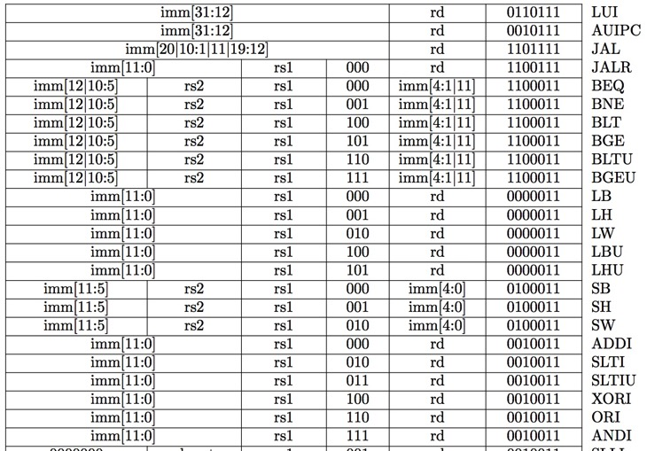
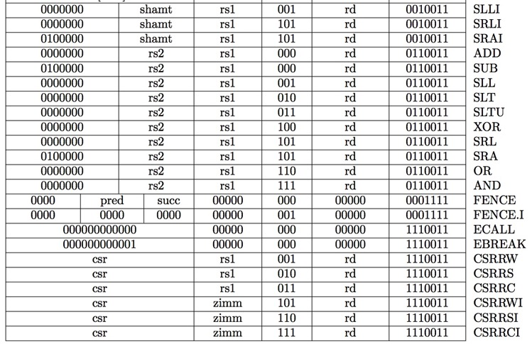
RV32I, a nine-bit ISA!
inst[30]
inst[14:12]
inst[6:2]
Not considered in the course
Instruction type encoded using only 9 bits inst[30],inst[14:12], inst[6:2]
Ref: CS61C Morgan Reschenberg, Univ of California, Berkeley

Slide 29
Control Logic Truth Table
Inst[31:0] | BrEq | BrLT | PCSel | ImmSel | BrUn | ASel | BSel | ALUSel | MemRW | RegWEn | WBSel
add | * | * | +4 | * | * | Reg | Reg | Add | Read | 1 | ALU
sub | * | * | +4 | * | * | Reg | Reg | Sub | Read | 1 | ALU
(R-R Op) | * | * | +4 | * | * | Reg | Reg | (Op) | Read | 1 | ALU
addi | * | * | +4 | I | * | Reg | Imm | Add | Read | 1 | ALU
lw | * | * | +4 | I | * | Reg | Imm | Add | Read | 1 | Mem
sw | * | * | +4 | S | * | Reg | Imm | Add | Write | 0 | *
beq | 0 | * | +4 | B | * | PC | Imm | Add | Read | 0 | *
beq | 1 | * | ALU | B | * | PC | Imm | Add | Read | 0 | *
bne | 0 | * | ALU | B | * | PC | Imm | Add | Read | 0 | *
bne | 1 | * | +4 | B | * | PC | Imm | Add | Read | 0 | *
blt | * | 1 | ALU | B | 0 | PC | Imm | Add | Read | 0 | *
bltu | * | 1 | ALU | B | 1 | PC | Imm | Add | Read | 0 | *
jalr | * | * | ALU | I | * | Reg | Imm | Add | Read | 1 | PC+4
jal | * | * | ALU | J | * | PC | Imm | Add | Read | 1 | PC+4
auipc | * | * | +4 | U | * | PC | Imm | Add | Read | 1 | ALU
CS 61c
Lecture 12: Control & Performance
Ref: CS61C Morgan Reschenberg, Univ of California, Berkeley

Slide 30
ROM Controller Implementation
AND
OR
add
sub
Control Word for add
Control Word for sub
Control Word for or
.
.
.
or
Address
Decoder
Inst[]
BrEQ
BrLT
11
.
.
.
jal
Controller output (PCSel, ImmSel, RegWEn…)
Ref: CS61C Morgan Reschenberg, Univ of California, Berkeley

Slide 31
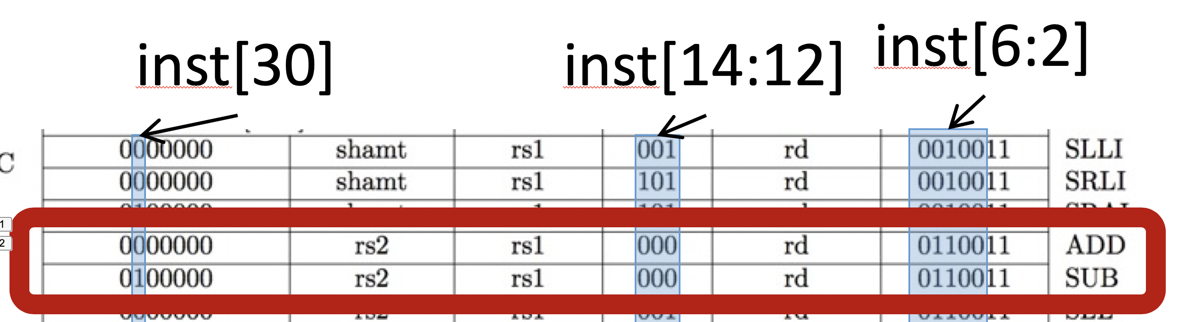
Zooming in on ADD and SUB
add = inst[30] • inst[14] • inst[13] • inst[12] • inst[6] • inst[5] • inst[4] • inst[3] • inst[2]
sub = inst[30] • inst[14] • inst[13] • inst[12] • inst[6] • inst[5] • inst[4] • inst[3] • inst[2]
RegWEn = add + sub + … (others that write to Reg)
Ref: CS61C Morgan Reschenberg, Univ of California, Berkeley

Slide 32
Class Summary
We have studied basic concepts of Control logic design
Focused on Add instruction control design
We have also studied performance of Single Cycle Datapath design
Not all instructions are active in all phases
Now, we will improve performance of Datapath by designing it using pipeline approach

